Slide 1
Module No 6
UiPath Orchestrator and Work Queues

Slide 2
Learning Objectives
Working with Orchestrator
Dashboard , Security, Robots, Process
Package publishing, Client Deployment, Robot & Machine provisioning
Work Queues
Working Example with Queues

Slide 3
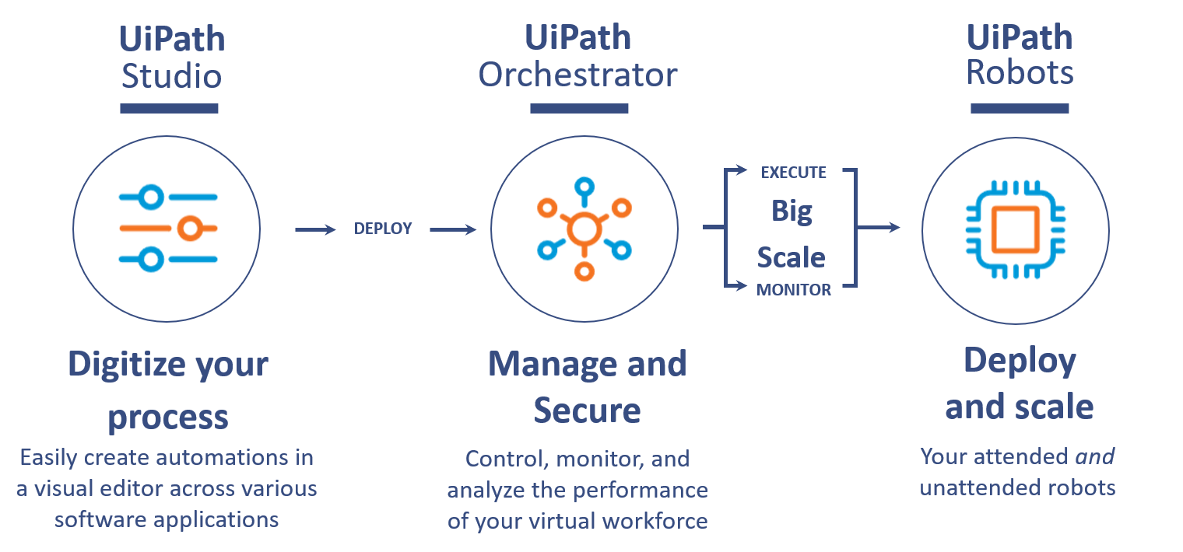
Introduction of UI Path Orchestrator
UiPath Orchestrator is a web application that enables you to orchestrate your UiPath Robots in executing repetitive business processes.
Orchestrator lets you manage the creation, monitoring, and deployment of resources in your environment.
Orchestrator Main Capabilities-
Provisioning - creates and maintains the connection between Robots and the web application
Deployment - assures the correct delivery of package versions to the assigned Robots for execution
Configuration - maintains and delivers Robot environments and processes configuration
Queues - ensures automatic workload distribution across Robots
Monitoring - keeps track of Robot identification data and maintains user permissions
Logging - stores and indexes the logs to an SQL database and/or Elasticsearch (depending on your architecture and configuration)
Inter-connectivity - acts as the centralized point of communication for 3rd party solutions or applications

Slide 4
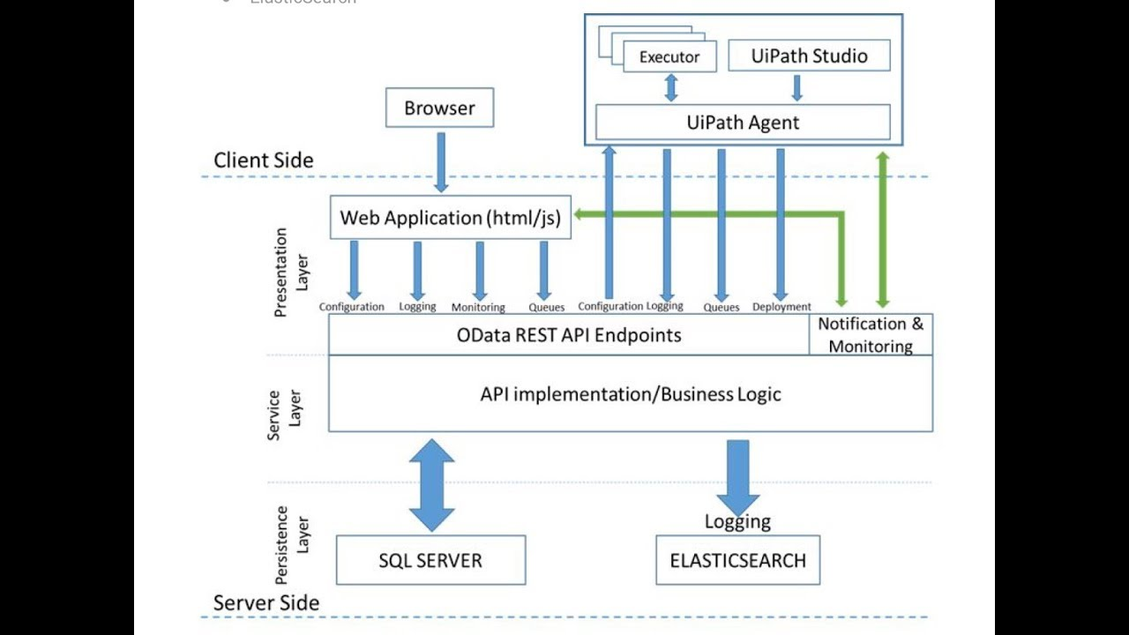
UiPath Orchestrator Logical Components
UiPath Orchestrator has some logical components, which are given as follows:
1. User Interface Layer:
Web Application
2. Web Services Layer:
Monitoring Service
Logging Service
Deployment Service
Configuration Service
Queues Service
3. Persistence Layer:
SQL Server
Elasticsearch
UiPath Orchestrator also provides OData REST API so that Third Party Application and Consume or Integrate with.

Slide 5
UiPath Orchestrator Key Concepts and Terms
Here are some of the basic concepts and terms in UiPath that you should get familiar with for the tutorial later:
Machine- Represents the actual machine the robot executes in
Package- A UiPath Studio project that is published
Process- A process represents the association between a package and an environment. Each time a package is deployed to an environment, it is automatically distributed to all machines that belong to that environment.
Job- A job is the execution of a process on one or multiple Robots.
Library- A process library describes a system of activities that are reusable for sharing
Schedule- Enables jobs to be executed in a preplanned manner
Asset- Usually represent shared variables or credentials that can be used in different projects.
Queue- A place to store multiple types of data, such as invoice information or customer details.

Slide 6
UiPath Orchestrator Demo
Trainer Will Demo Each Tab of UiPath Orchestrator...

Slide 7
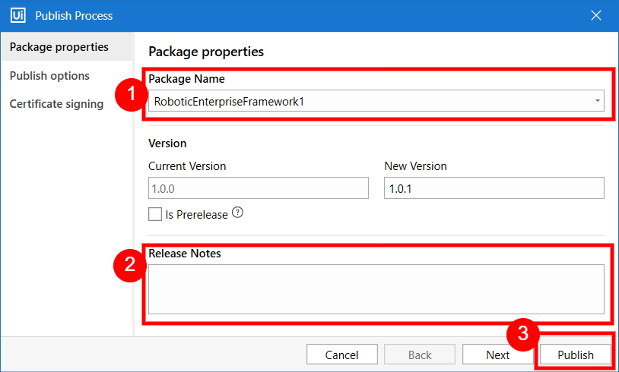
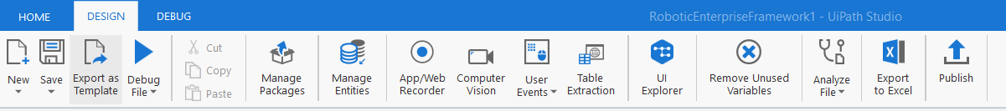
Publish a Process to UI Path Orchestrator
How to publish a workflow in UiPath
The following are the steps to be followed to publish a workflow in UiPath:
First, open UiPath Studio, create a new project, and give it an appropriate name. Or Open Existing Project
Go to the DESIGN Ribbon and click on the Publish button.
If everything goes well, You will get confirmation message.
When we publish the package to Orchestrator Server then it automatically reaches the server and can be viewed on the Packages page.

Slide 8
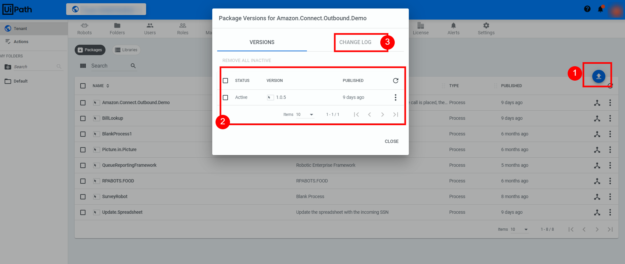
Publish a Process to UI Path Orchestrator
However, if somehow the package is not found on the Orchestrator Server then we can add a package manually as well. Or Incase you don’t have required access you can pass your package to be Uploaded Directly.
The Other Important feature here is , You can Rollback the Changes and you can use old package by making them active and inactive.

Slide 9
UiPath Orchestrator Demo
Trainer Will Demo Publishing Package on Orchestrator...

Slide 10
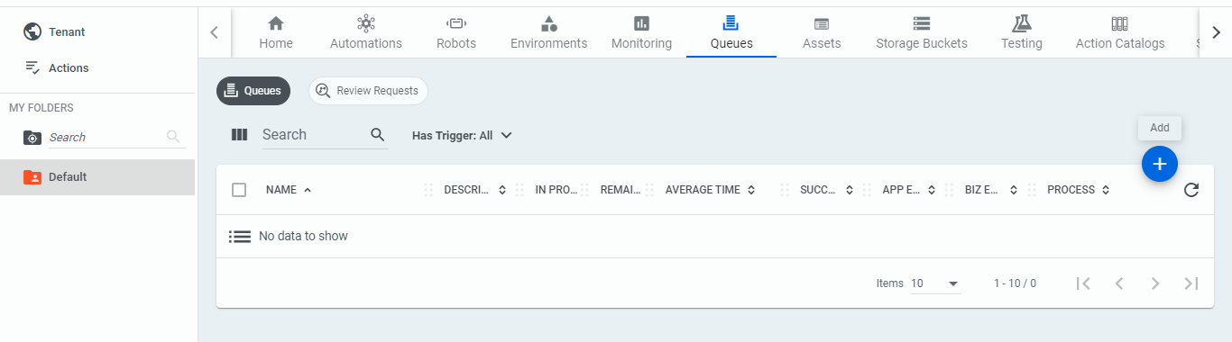
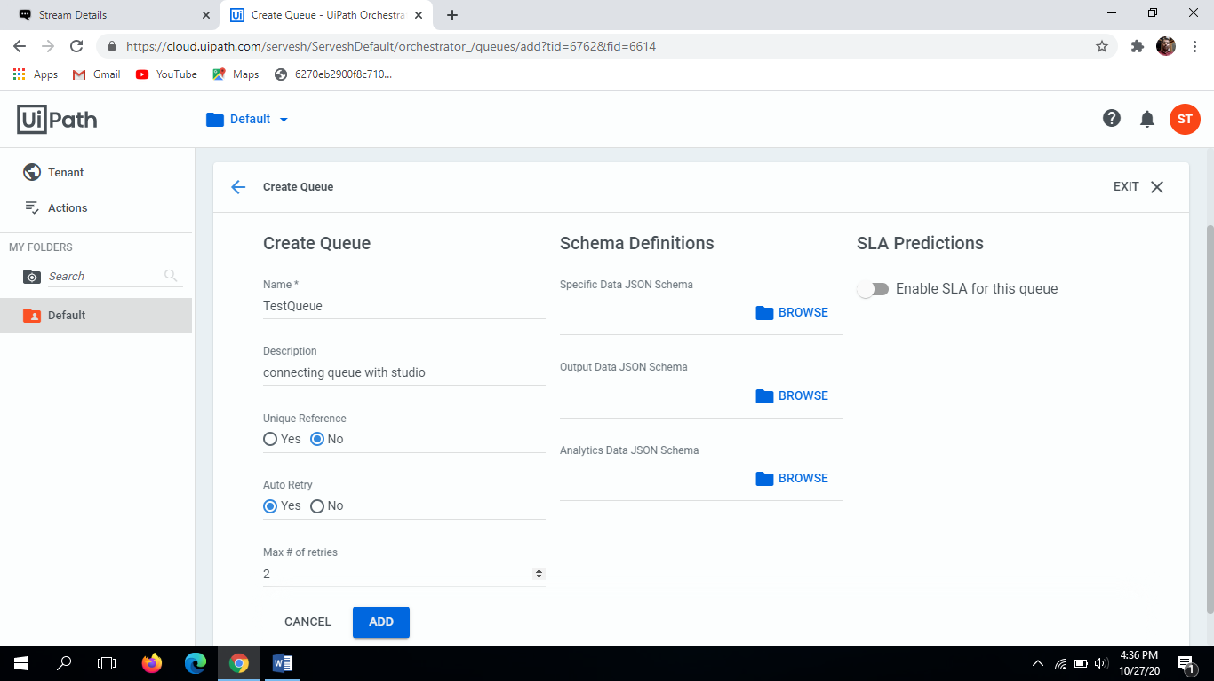
UiPath Queues
A queue is a container that enables you to hold an unlimited number of items.
Queue items can store multiple types of data, such as invoice information or customer details.
A queue is usually considered as a list of pending jobs, executed by priority or other criteria related to the underlying order several jobs are executed. However, in UiPath, queues are related to information obtained or generated by the bot, that is, inputs and outputs.
The bot stores the information in a queue, where the information remains stored by the Orchestrator so that it can be retrieved later by other bots.
So, a queue is a container of data held so other bots or applications can use it.
Navigate: Login to Orchestrator > Click on the Queue Option > Click on the Add (+) icon.
Enter the mandatory Queue Name, Description, Unique Reference (Y/N), Auto Retry (Y/N), enter Max Retry if yes and Enable/Disable SLA.

Slide 11
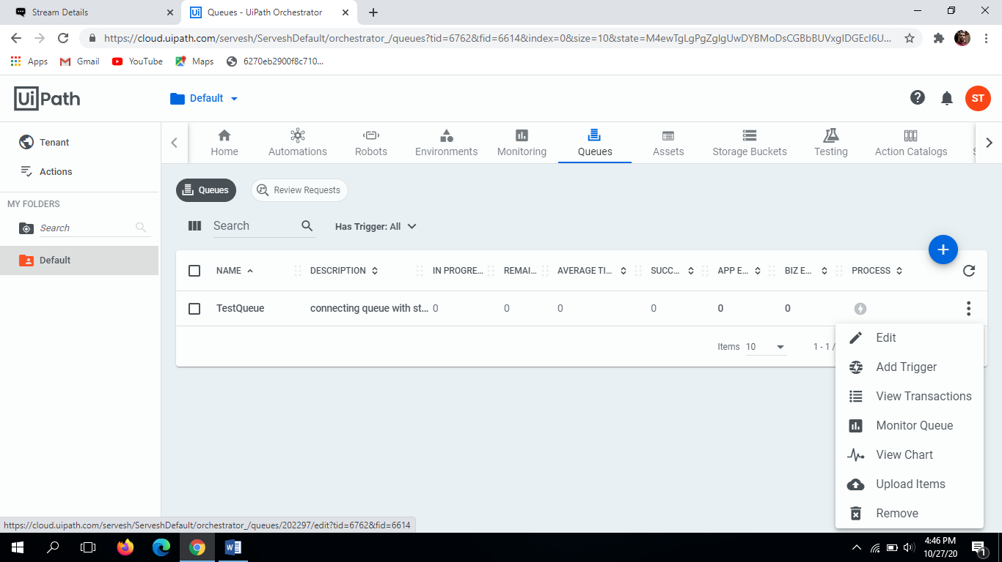
Manage UiPath Queues
You can Edit, Monitor, Remove the Queue at any time by clicking on the actions icon.
To view the items in a specific queue you have to click View Transactions. On clicking the Transactions page is displayed where you can view all the items with its status.

Slide 12
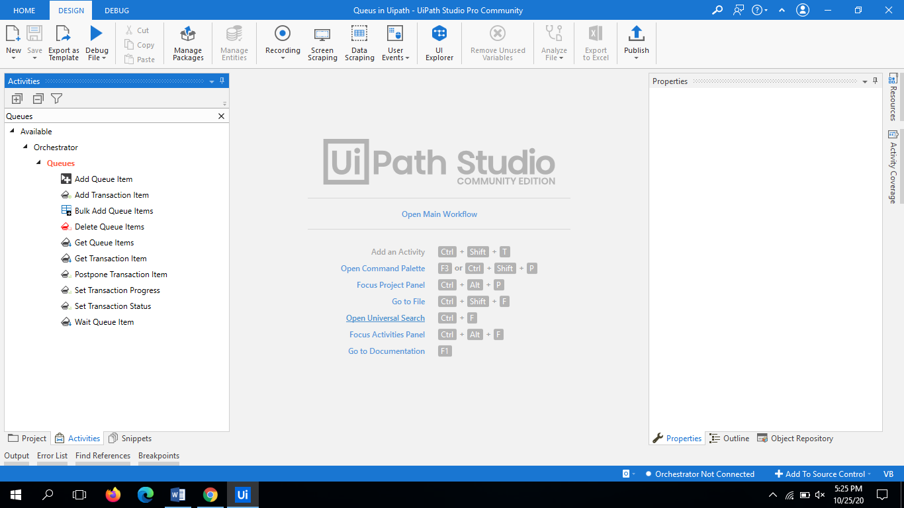
How to use UiPath Queues
While developing the workflow for any process the Queues are managed by the RPA developers. There are various activities that help the UiPath Studio to communicate with the Orchestrator Queues.
So the studio activities that helps in communicating with the Orchestrator Queues are as follows:
Add Queue Item
Add Transaction Item
Bulk Add Queue Items
Get Transaction Item
Delete Queue Items
Get Queue Items
Postpone Transaction Item
Set Transaction Status
Set Transaction Progress
Wait Queue Item
These can be found in the Activities panel under Orchestrator -> Queues as shown :

Slide 13
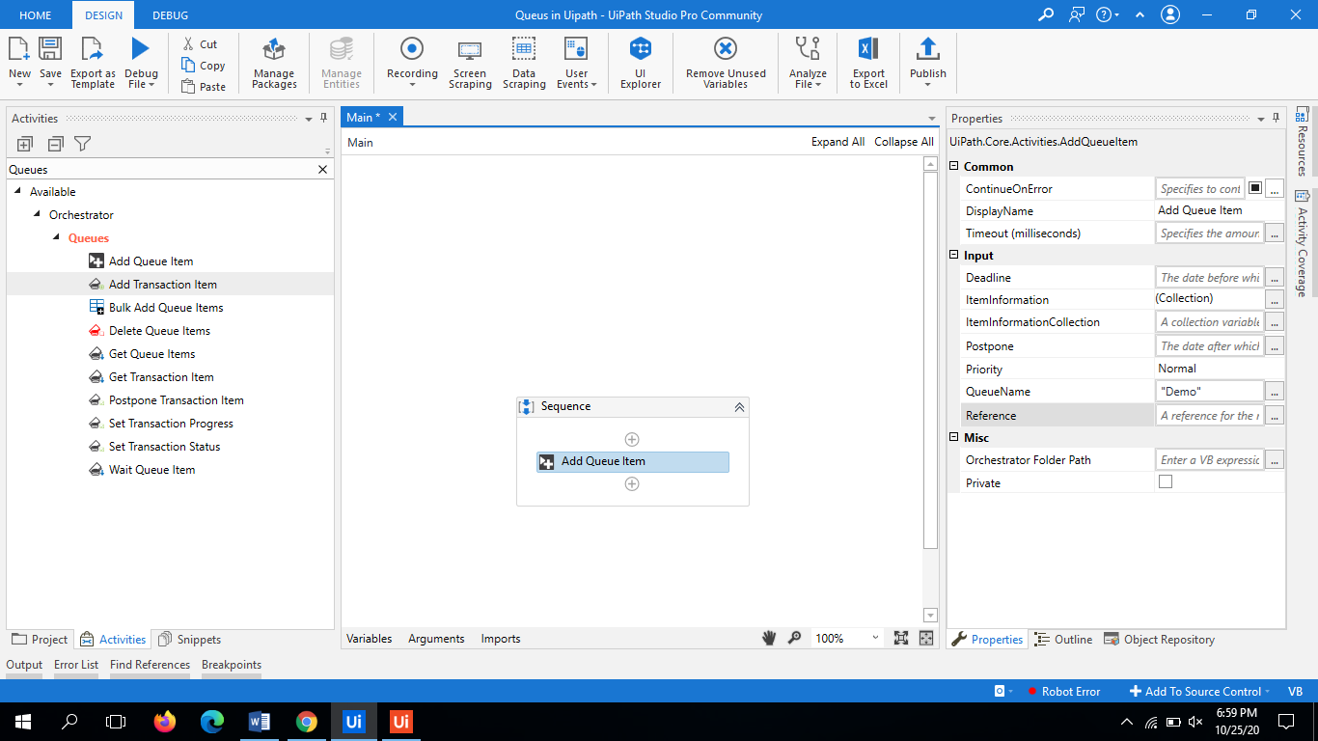
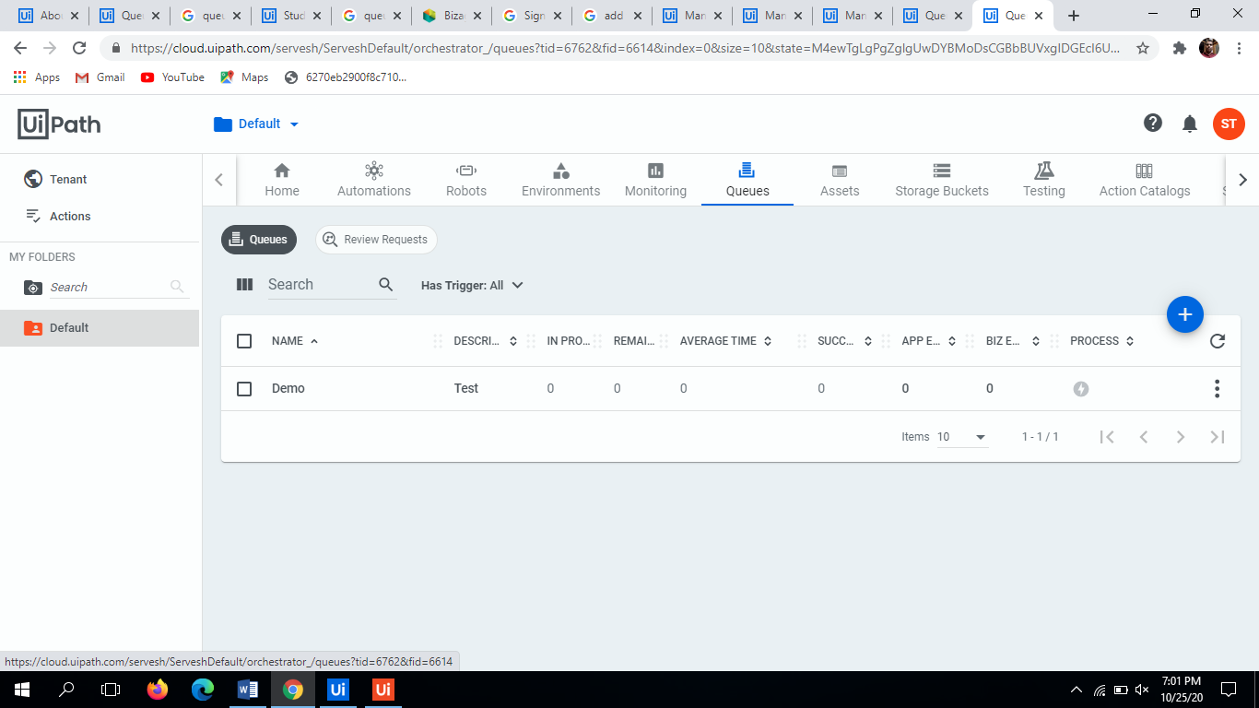
UiPath - Add Queue Item
This activity helps to add data (item) in the Queue in UiPath. The status of the item will be New in the Queue.
`UiPath.Core.Activities.AddQueueItem`
Configurations in Properties Panel:
Queue Name: The queue where the Queue Item object is to be added. The Queue Name should be same as the Queue created in the Orchestrator.
Reference: The reference can be used to link your transactions to other applications used within an automation project.
ItemInformationCollection: This field accepts the dictionary variables. This enables importing an entire dictionary of information for a queue item.
Dictionary<string, object>
Deadline - The date before which the queue item should be processed. This property can be filled in with relative dates such as DateTime.Now.AddHours(2), DateTime.Now.AddDays(10) and DateTime.Now.Add(New System.TimeSpan(5, 0, 0, 0))

Slide 14
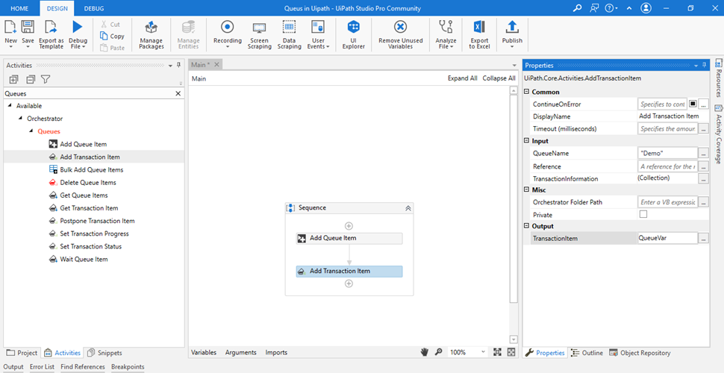
UiPath -Add Transaction Item
Add Transaction Item
This activity adds an item in the queue, starts the transaction and sets the status to In Progress. It can also be configured to add a custom reference to each transaction. The status of the item is set to **InProgress**. Returns the item as a `QueueItem` variable.
`UiPath.Core.Activities.AddTransactionItem`

Slide 15
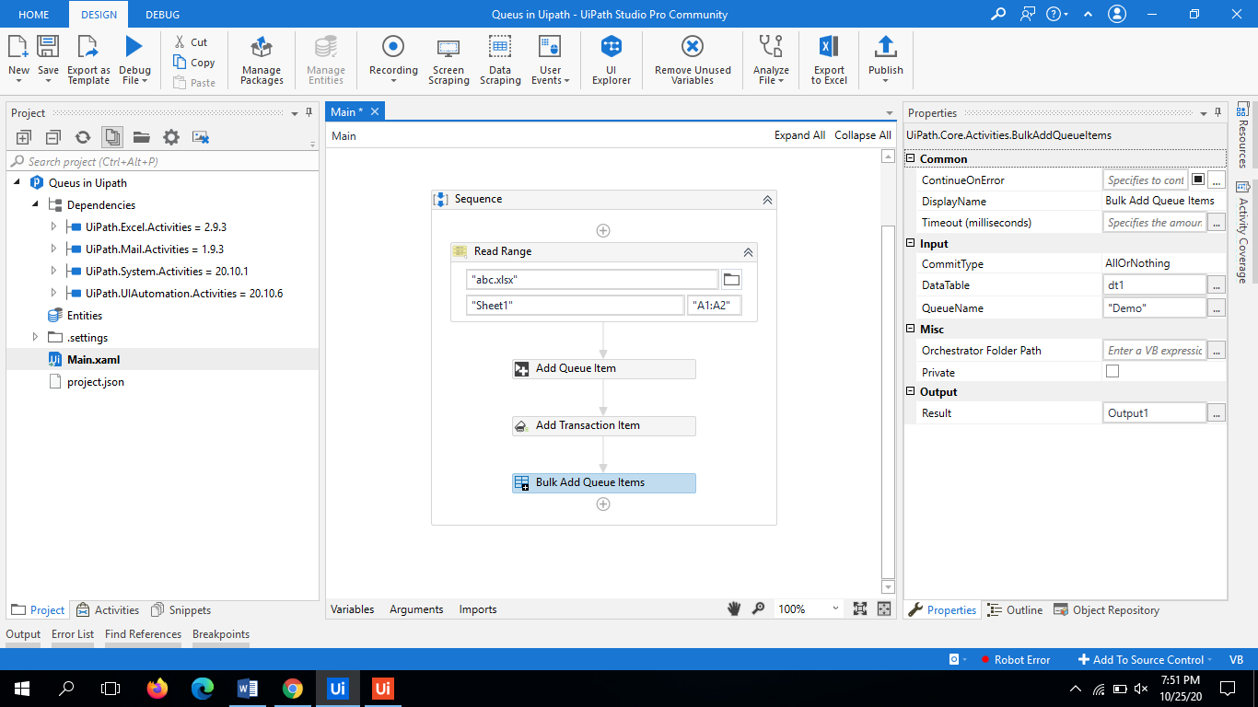
UiPath -Bulk Add Queue Items
This activity adds the items from a specified Datatable to the queue in orchestrator. The items once added in the Queue the statuses are changed to New.
UiPath.Core.Activities.BulkAddQueueItems

Slide 16
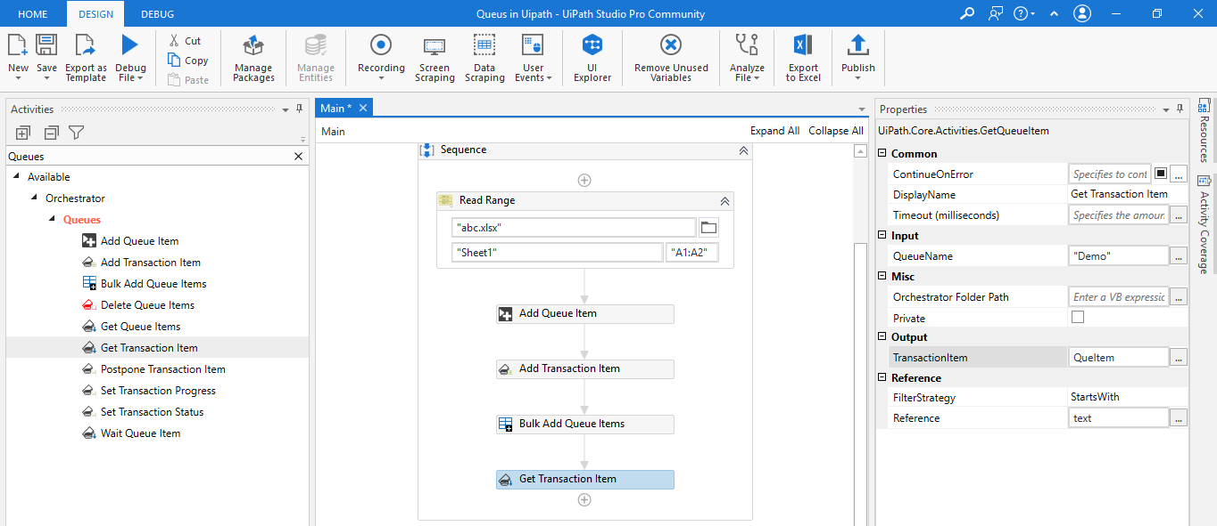
UiPath - Get Transaction Item
This activity is used to get the item from the orchestrator queue to process and sets its status to In-progress. Starting its processing makes it a transaction.
‘UiPath.Core.Activities.GetQueueItem’

Slide 17
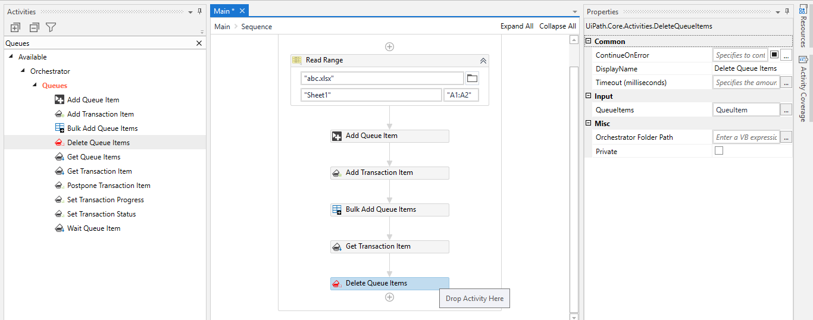
UiPath - Delete Queue Item
Enables you to delete items with the ‘New’ state from a specified queue.
‘UiPath.Core.Activities.DeleteQueueItems’

Slide 18
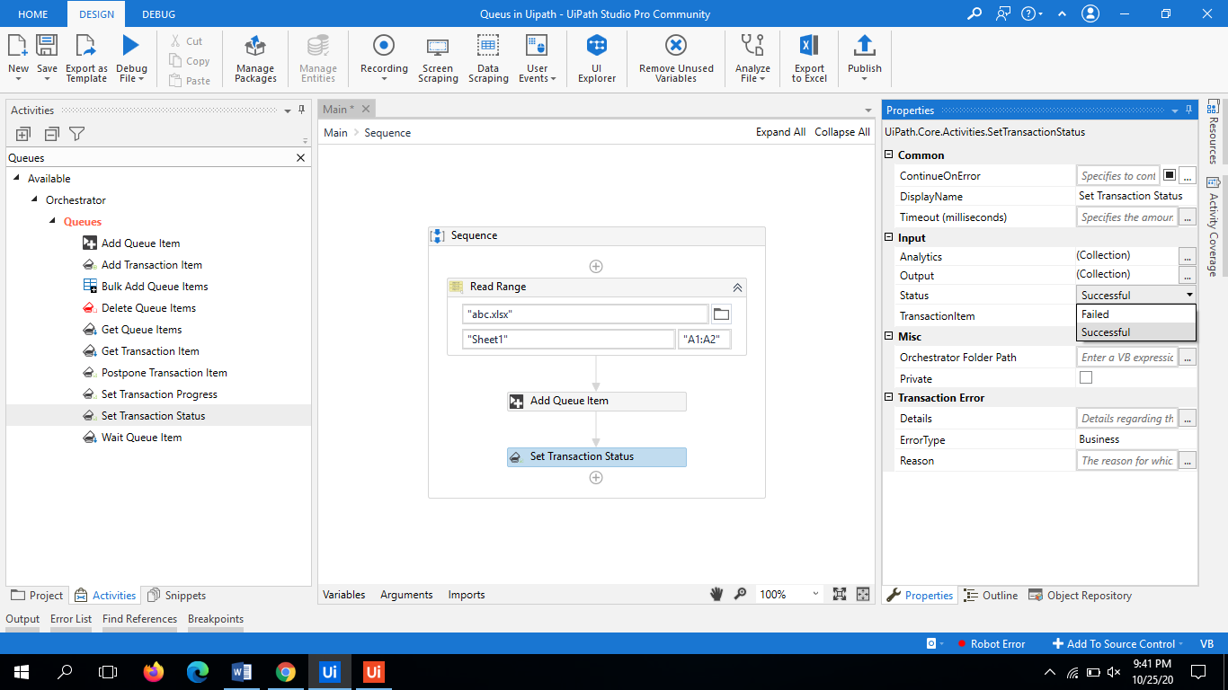
UiPath - Set Transaction Status
This activity is used to set the transaction status of item to Failed or Successful.
Inputs:
Output - A collection of additional information about the specific TransactionItem whose status is to be updated.
Status - The status that is to be set to the TransactionItem (Failed/Successful).
TransactionItem - The TransactionItem whose status is to be updated.

Slide 19
UiPath – Working Example on Queue
Trainer Will Demo Queue Example on Orchestrator...

Slide 20
UiPath – Working Example on Queue
Conclusion
Queues enables to create large automation projects underlies by complex logic. The Item Statuses are controlled by the developers of UiPath and the Revision Status are controlled I Orchestrator.
By Default the Queue items that have been processed successfully are archived on a daily basis, while the others remain in the queue so that you can decide what to do with them.
References
https://forum.uipath.com/t/bulk-add-queue-items-is-there-a-maximum-data-size-what-is-a-suggested-work-around/207184
https://docs.uipath.com/orchestrator/docs/about-queues-and-transactions

